Slide 1
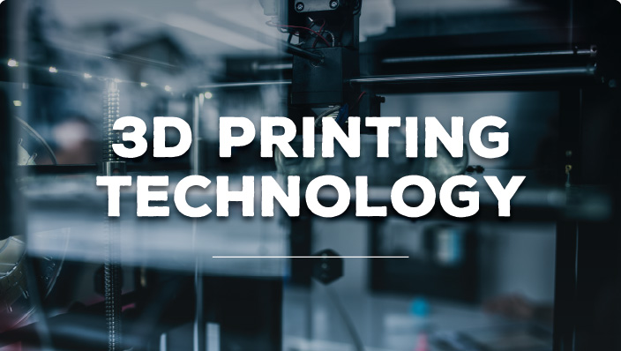
REVA DHILLON (1041702)
BHARATHWAJ R (1004968)
CHAITANYA VARMA RUDRARAJU(1037595)
RAGALA YASWANTH KUMAR (2002674)

Slide 2
Acknowledgements
We would like to express our earnest gratitude to our teachers Ms. M Prathilothamai, Mr. A K Sumesh and Ms. Syama for giving us the opportunity to expand our knowledge on this fascinating subject. We truly enjoyed exploring the various facets of this topic. It has been an enriching experience.

Slide 3
Table of Contents
Introduction
Outline of the process
3D printing software
Slicing Software
Additive Manufacturing Process
Strengths and limitations of 3D printing
Conclusion
Bibliography

Slide 4
3D CAD MODEL
STL FILE
SLICING SOFTWARE
LAYER SLICES & TOOL PATHS
ADDITIVE MANUFACTURING
POST PROCESSING
1
J
2
OUTFLOW PROCESS OF 3D PRINTING
3
4
5
6

Slide 5
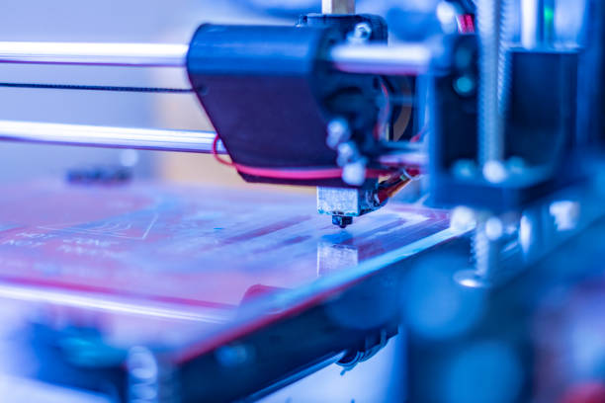
WHAT IS 3D PRINTING SOFTWARE
3D printing transforms 3D models into real models that you can touch and use in the real world with computer-aided design (CAD) models. The software takes the 3D model as the input and directs the 3D printer to create a replica of the model.
Although G-Code is the standard language for most 3D printers, some machines may use different file formats or commands.

Slide 6
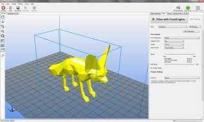
SOME SOFTWARES FOR 3D PRINTING
Tinkercad
FreeCAD
It’s designed to allow anyone to create 3D printable models and serves as an introduction to solid modeling.
Models are fully parametric and recalculated on demand with an undo/redo stack. Other features include robotic simulation, architectural tools, and a path module for CAM (Computer Aided Manufacturing).
Cura
3D Slash
Cura is the benchmark slicer software for all Ultimaker 3D printers, but it can also be used with most other 3D printers
Models are created through “slashing” 3D blocks away to shape them as desired.
Fusion 360
Lots of features, such as tools modeling and sculpting, generative design, simulation, assemblies, collaboration, 3D printing, and CAM

Slide 7
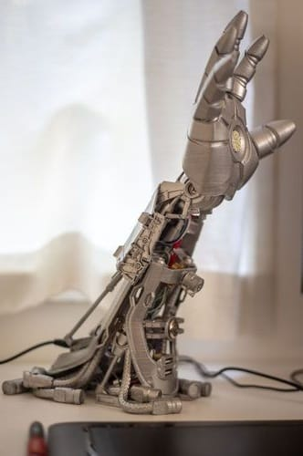
Additive Manufacturing
Additive Manufacturing (AM) is defined as a building of 3D objects by adding layer-upon-layer of material, whether the material may be plastic, metal, concrete
In Additive Manufacturing technology, once a Computer Aided Design (CAD) model is created, the AM equipment reads the data from the CAD file and automatically removing or adding a successive layers of liquid, powder, sheet material in a layer-upon-layer, to fabricate a 3D object, Simply AM is used for making a product from CAD model

Slide 8
PRO
Strong and light weight parts
Flexible Design
CONS
Deaign Inaccuracy
Restricted Build Size
Fast Design and Production
Print On Demand
Limited Materials
Reduction in Manufacturing Jobs

Slide 9
Bibliography
https://3dprinting.com/what-is-3d- printing/#3D-Printing-Technologies
https://3dprinting.com/software/ #SLICERS-3D-PRINTER-HOSTS
https://3dprinting.com/3d-printinguse-cases/3d-printing-as-a-production- technology/
https://en.wikipedia.org/wiki/ 3D_printing
https://en.wikipedia.org/wiki/ Slicer_(3D_printing)
https://monroeengineering.com/blog/ the-role-slicing-plays-in-3d-printing/

Slide 10


